Slide 1
CHAPTER
16 Labor Markets

Slide 2
Allocation of Time
Individuals
  Must decide how to allocate the fixed amount of time they have
Assume that there are only two uses of an individual’s time
  Engaging in market work at a real hourly wage rate of w
  Leisure (nonwork)
  Simple two-good model

Slide 3
Simple Two-Good Model
Assume that an individual’s utility
  Depends on consumption (c) and hours of leisure (h): utility = U(c,h)
In seeking to maximize utility, the individual is bound by two constraints
  Available time: l + h = 24, where l is hours of work
  Income constraint: c = wl

Slide 4
Simple Two-Good Model
Combining the two constraints:
c = w(24 – h)
c + wh = 24w
An individual has a “full income” of 24w
  May spend the full income either by working (for real income and consumption) or by not working (enjoying leisure)
  The opportunity cost of leisure is w

Slide 5
Utility Maximization
Maximize utility subject to the full income constraint
  Setting up the Lagrangian
ℒ = U(c,h) + λ(24w – c – wh)
  The first-order conditions:
∂ℒ /∂c = ∂U/∂c - λ = 0
∂ℒ /∂h = ∂U/∂h - λ = 0

Slide 6
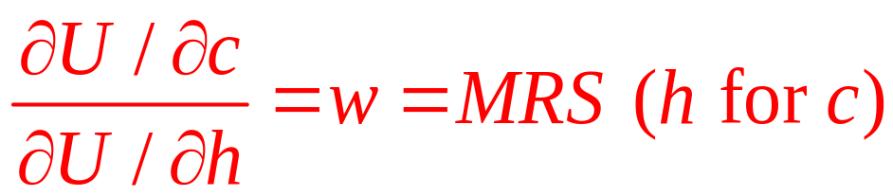
Utility Maximization
Dividing the two, we get
Utility-maximizing labor supply decision
  To maximize utility, the individual should choose to work that number of hours for which the MRS (of h for c) is equal to w
    To be a true maximum, the MRS (of h for c) must be diminishing

Slide 7
Income and Substitution Effects
Both a substitution effect and an income effect occur when w changes
  When w rises, the price of leisure rises
    And the individual will choose less leisure
  Because leisure is a normal good
    An increase in w leads to an increase in leisure
The income and substitution effects
  Move in opposite directions

Slide 8
16.1 Income and Substitution Effects of a Change in the Real Wage Rate w
Consumption
Consumption
c = w₁ (24-h)
c = w₁ (24-h)
c = w₀ (24-h)
c = w₀ (24-h)
c₁
c₁
S
S
c₀
U₁
U₁
c₀
U₀
U₀
h₁
h₀
Leisure
h₀
h₁
Leisure
Because the individual is a supplier of labor, the income and substitution effects of an increase in the real wage rate (w) work in opposite directions in their effects on the hours of leisure demanded (or on hours of work). In (a) the substitution effect (movement to point S) outweighs the income effect, and a higher wage causes hours of leisure to decrease to h₁. Therefore, hours of work increase. In (b) the income effect is stronger than the substitution effect, and h increases to h₁. In this case, hours of work decrease.

Slide 9
A Mathematical Analysis of Labor Supply
Budget constraint
  Allow for the possibility of nonlabor income:
  c = wl + n
Maximization of utility subject to this constraint
  Yields identical results
  As long as n is unaffected by the labor-leisure choice

Slide 10
A Mathematical Analysis of Labor Supply
Nonlabor income
  Shifts the budget constraint out (or in) in a parallel fashion
Individual’s labor supply function, l(w,n)
  Hours worked depend on
    The wage
    The amount of nonlabor income
  Since leisure is a normal good, ∂l/∂n < 0

Slide 11
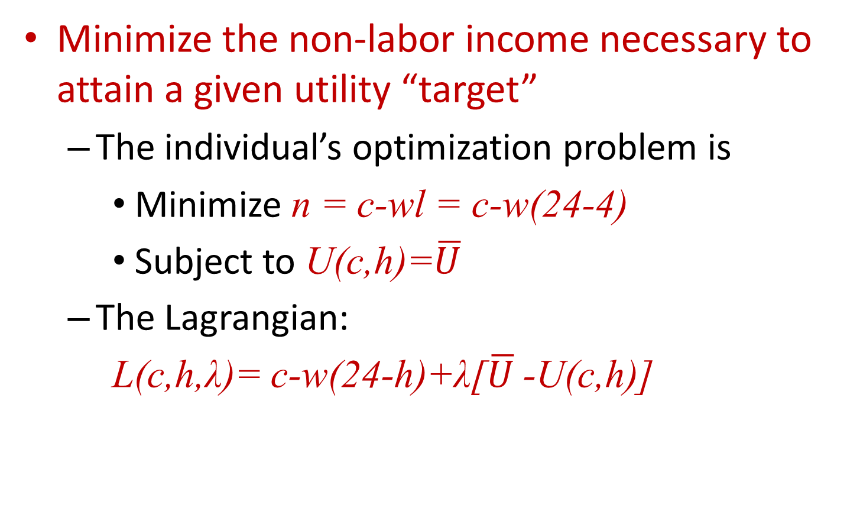
Dual to the Labor Supply Problem
Minimize the non-labor income necessary to attain a given utility “target”
  The individual’s optimization problem is
    Minimize n = c-wl = c-w(24-4)
    Subject to U(c,h)=$\overline{U}$
  The Lagrangian:
  L(c,h,λ)= c-w(24-h)+λ[$\overline{U}$ -U(c,h)]

Slide 12
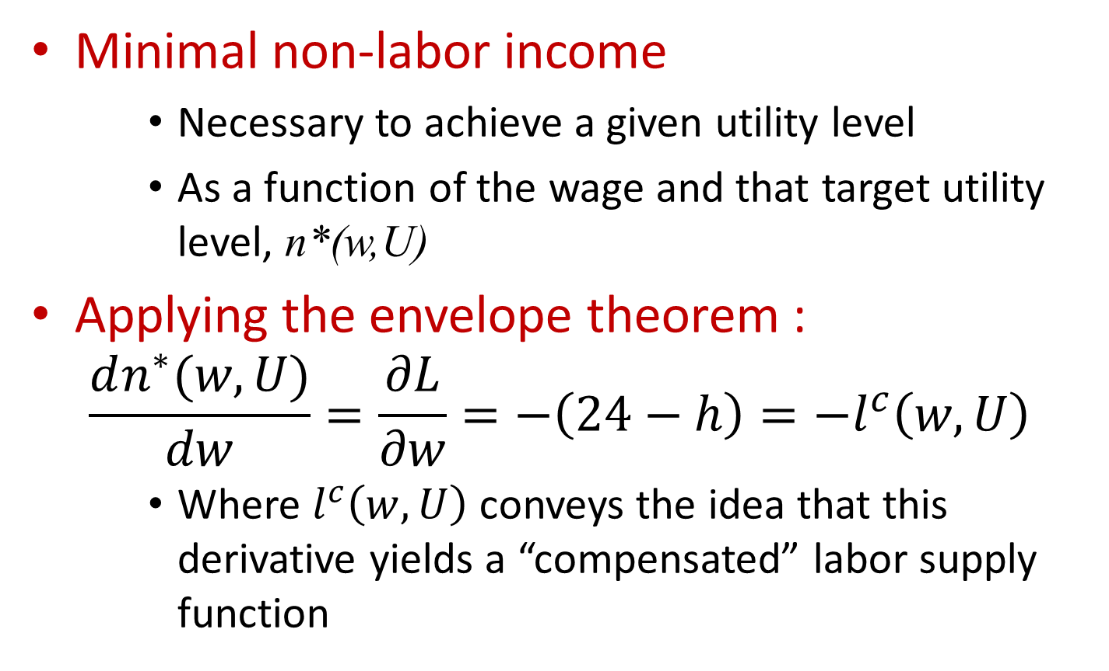
Dual to the Labor Supply Problem
Minimal non-labor income
    Necessary to achieve a given utility level
    As a function of the wage and that target utility level, n*(w,U)
Applying the envelope theorem :
  $$\frac{dn^{∗}(w,U)}{dw}=\frac{∂L}{∂w}=−\left(24−h\right)=−l^{c}\left(w,U\right)$$
    Where $l^{c}\left(w,U\right)$ conveys the idea that this derivative yields a “compensated” labor supply function

Slide 13
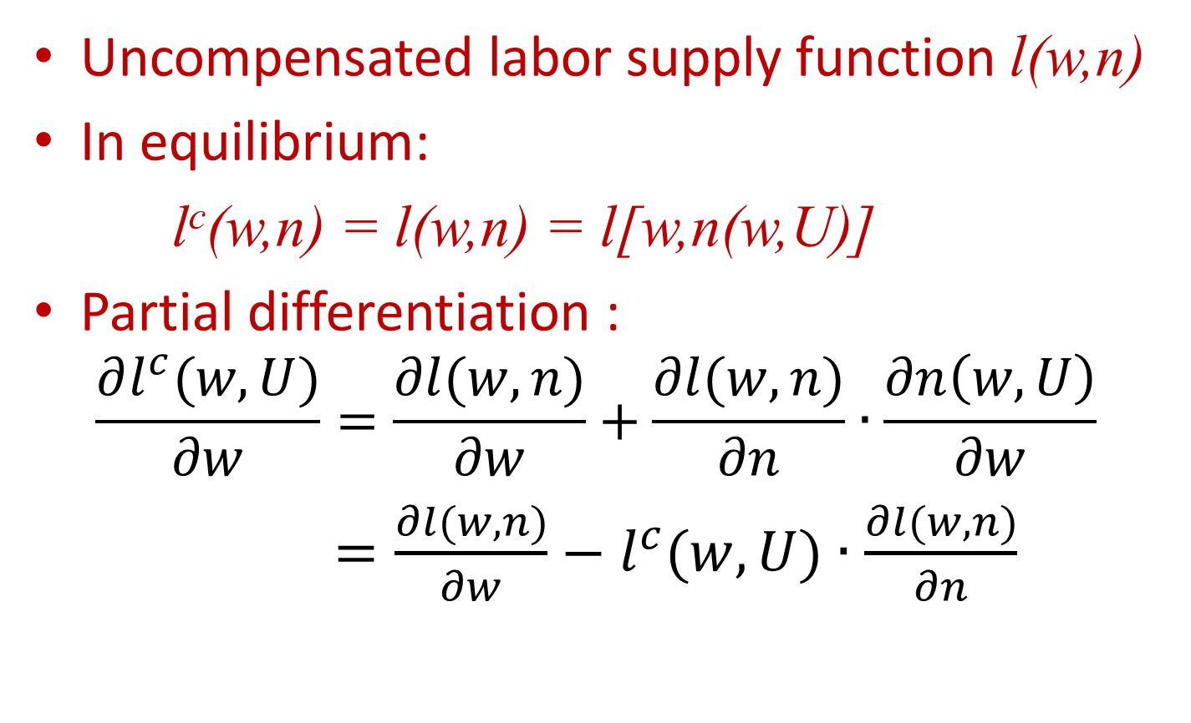
Slutsky Equation for Labor Supply
Uncompensated labor supply function l(w,n)
In equilibrium:
l^{c}(w,n) = l(w,n) = l[w,n(w,U)]
Partial differentiation :
  $$\frac{∂l^{c}(w,U)}{∂w}=\frac{∂l(w,n)}{∂w}+\frac{∂l(w,n)}{∂n}∙\frac{∂n\left(w,U\right)}{∂w}$$
  $=\frac{∂l(w,n)}{∂w}−l^{c}(w,U)∙\frac{∂l(w,n)}{∂n}$

Slide 14
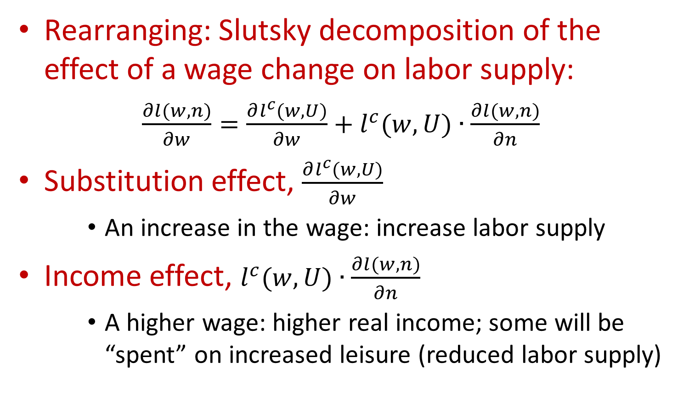
Slutsky Equation for Labor Supply
Rearranging: Slutsky decomposition of the effect of a wage change on labor supply:
$\frac{∂l(w,n)}{∂w}=\frac{∂l^{c}(w,U)}{∂w}+l^{c}(w,U)∙\frac{∂l(w,n)}{∂n}$
Substitution effect, $\frac{∂l^{c}(w,U)}{∂w}$
    An increase in the wage: increase labor supply
Income effect, $l^{c}(w,U)∙\frac{∂l(w,n)}{∂n}$
    A higher wage: higher real income; some will be “spent” on increased leisure (reduced labor supply)

Slide 15
16.1 Labor Supply Functions
1. Cobb–Douglas utility
  An individual’s utility function for consumption (c), and leisure (h): U(c,h) = c^{α}h^{β}
    Assume α + β = 1
  Constraints
    Income constraint: c = wl + n
    Total time constraint: l + h = 1
  Lagrangian expression:
ℒ =U(c,h)+λ(w+n–wh–c)=c^{α}h^{β}+λ(w+n–wh–c)

Slide 16
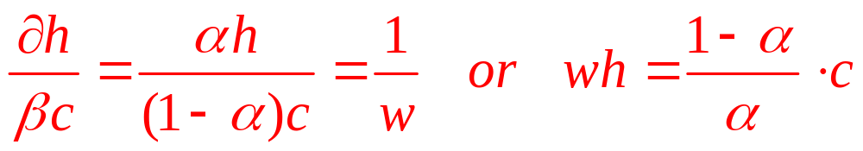
16.1 Labor Supply Functions
1. Cobb–Douglas utility
  First-order conditions for a maximum
∂ℒ /∂c = αc^{-β}h^{β} - λ = 0
∂ℒ /∂h = βc^{α}h^{-α} - λw = 0
∂ℒ /∂λ = w + n - wh - c = 0
  Dividing the first by the second yields

Slide 17
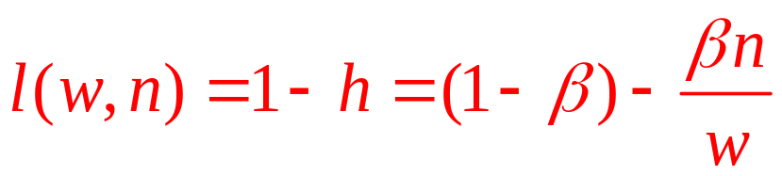
16.1 Labor Supply Functions
1. Cobb–Douglas utility
  Substitution into the full income constraint yields
c = α(w + n) and h = β(w + n)/w
    The person spends α of his income on consumption and β = 1-α on leisure
    The labor supply function is:

Slide 18
16.1 Labor Supply Functions
2. Properties of the Cobb–Douglas labor supply function
If n = 0
  The person will work (1-β) of each hour no matter what the wage is
  The substitution and income effects of a change in w offset each other and leave l unaffected
If n > 0, ∂l/∂w > 0
  The individual will always choose to spend βn on leisure
  Since leisure costs w per hour, an increase in w means that less leisure can be bought with n

Slide 19
16.1 Labor Supply Functions
2. Properties of the Cobb–Douglas labor supply function
Note that ∂l/∂n < 0
  An increase in nonlabor income allows this person to buy more leisure
    Income transfer programs are likely to reduce labor supply
    Lump-sum taxes will increase labor supply

Slide 20
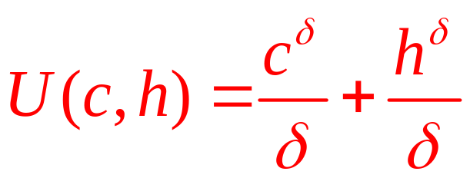
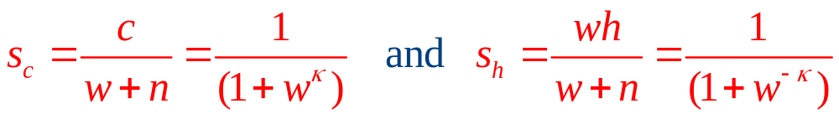
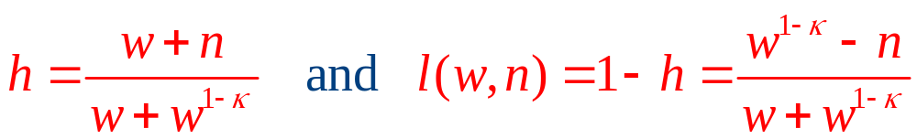
16.1 Labor Supply Functions
3. CES labor supply
  Utility function:
  Budget share equations are given by
      where κ = δ/(δ-1)
    Solving for leisure gives

Slide 21
Market Supply Curve For Labor
Market supply of labor
  Derived from individual labor supply decisions
  At each possible wage rate
    Add together the quantity of labor offered by each individual to arrive at a market total
  As the wage rate increases
    More individuals may be induced to enter the labor force

Slide 22
16.2 Construction of the Market Supply Curve for
Labor
Real
wage
Real
wage
Real
wage
S₁
S₂
S
w₃
w₂
w₁
Hours
Hours
Total labor supply
(a) Individual 1
(b) Individual 2
(c) The market
As the real wage increases, there are two reasons why the supply of labor may increase. First, higher real wages may cause each person in the market to work more hours. Second, higher wages may induce more individuals (for example, individual 2) to enter the labor market.

Slide 23
Labor Market Equilibrium
Equilibrium in the labor market
  Established through the interactions of
    Individuals’ labor supply decisions
    Firms’ decisions about how much labor to hire
  At a real wage rate of w*
    Quantity of labor demanded by firms is precisely matched by the quantity supplied by individuals

Slide 24
16.3 Equilibrium in the Labor Market
Real wage
S
w*
D
l*
Quantity of labor
A real wage of w* creates an equilibrium in the labor market with an employment level of l*.

Slide 25
Labor Market Equilibrium
A real wage higher than w*
  Disequilibrium: quantity of labor supplied is greater than the quantity demanded
    Some involuntary unemployment
    May create pressure for the real wage to decrease
A real wage lower than w*
  Disequilibrium: firms want to hire more workers than are available
    May bid up real wages to restore equilibrium

Slide 26
16.2 Mandated Benefits
Recent laws
  Have mandated that employers provide special benefits to workers
    Health insurance
    Paid time off
    Minimum severance packages
Effects of these mandates
  Depend on how much the employee values the benefit

Slide 27
16.2 Mandated Benefits
Prior to the mandate
  Supply and demand for labor are: l_{S} = a + bw and l_{D} = c – dw
  Equilibrium: l_{S} = l_{D}
    Equilibrium wage: w* = (c – a)/(b + d)
The government mandates
  That all firms provide a benefit to their workers that costs t per unit of labor hired
    Unit labor costs become w + t
  The benefit has a value of k per unit supplied
    Net return from employment: w + k

Slide 28
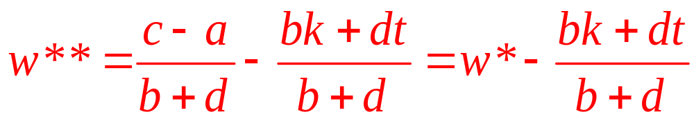
16.2 Mandated Benefits
With the mandate
  Equilibrium in the labor market:
a + b(w + k) = c – d(w + t)
  Net wage:
If k = 0
  The mandate is just like a tax on employment
  Similar results will occur as long as k < t

Slide 29
16.2 Mandated Benefits
If k = t
  The new wage falls precisely by the amount of the cost
  And the equilibrium level of employment does not change
If k > t
  The new wage falls by more than the cost of the benefit
  And the equilibrium level of employment rises

Slide 30
Wage Variation
Three major causes of wage differences:
  Human capital
  Compensating wage differentials
  Job search uncertainty

Slide 31
Human Capital
Human Capital
  Differences in human capital translate into differences in worker productivities
    Workers with greater productivities would be expected to earn higher wages
  General human capital
  Specific human capital

Slide 32
16.3 General and Specific Human Capital
A firm and a worker are entering into a two-period employment relationship
  In the first period the firm must decide
    How much to pay the worker (w₁)
    How much to invest in general (g) and specific (s) human capital for this worker
  The value of the worker’s marginal product
    In the first period: v₁
    In the second period: v₂(g,s) = v₁+ v^{g}(g) + v^{s}(s)
      Where v^{g} and v^{s} - increase in human capital as a result of the firm’s investments in period one

Slide 33
16.3 General and Specific Human Capital
Both human capital investments are profitable
v^{g}(g) > p_{g}g and v^{s}(s) > p_{s}s
Profits for the firm:
π₁ = v₁ – w₁ – p_{g}g – p_{s}s and π₂ = v₁ + v^{g}(g) + v^{s}(s) – w₂
π = π₁ + π₂ = 2v₁ + v^{g}(g) – p_{g}g + v^{s}(s) – p_{s}s – w₁ – w₂
The worker
  Wishes to maximize w₁ + w₂
The firm
  Wishes to maximize two-period profits

Slide 34
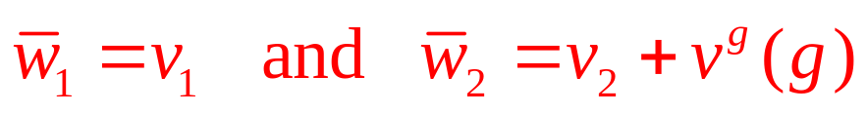
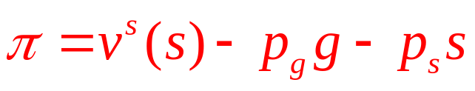
16.3 General and Specific Human Capital
Alternative wages:
Profits:
  Firm’s optimal choice: g=0
    If the firm cannot earn any return on its investment in general human capital
    Its profit-maximizing decision is to refrain from such investing

Slide 35
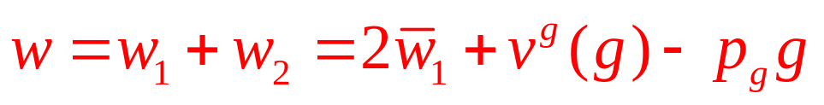
16.3 General and Specific Human Capital
The worker
  Higher wage with such added human capital
  May opt to pay for his or her own general human capital accumulation
    By taking a reduction in first-period wages
  Total wages:
  First-order condition: ∂v^{g}(g)/∂g = p_{g}
The firm
  First-order condition for a profit-maximizing choice of s: ∂v^{s}(s)/∂s = p_{s}

Slide 36
Compensating Differentials
Compensating Differentials
  Individuals prefer some jobs to others
  Desirable job characteristics may make a person willing to take a job that pays less than others
  Jobs that are unpleasant or dangerous will require higher wages to attract workers

Slide 37
Compensating Differentials
Firm’s output, q = f(l, A)
  Is a function of the labor it hires (l) and the amenities it provides to its workers (A)
    Amenities are productive, f_{A} > 0
    Exhibit diminishing marginal productivity, f_{AA} < 0
Firm’s profits:
π(l,A)=pf(l,A) – wl – p_{A}A

Slide 38
Compensating Differentials
Wage levels
  Can change in response to amenities provided on the job
  w = w₀ – k(A – A*)
Firm’s profits:
π(l,A)=pf(l,A) – [w₀ – k(A – A*)]l – p_{A}A
First-order condition:
∂π/∂A = pf_{A} + kl – p_{A} = 0 or pf_{A} = p_{A} – kl

Slide 39
Compensating Differentials
The firm
  Upward sloping ‘‘supply curve’’ for amenities
    A higher level of k causes the firm to choose to provide more amenities to its workers
The worker
  Valuation of amenities - derived from his utility function, U(w, A)
  Choose among employment opportunities: maximizes utility subject to the budget constraint w = w₀ - k(A – A*)

Slide 40
Compensating Differentials
The worker
  First-order conditions: MRS = U_{A}/U_{w} = k
  Will choose a job that offers a combination of wages and amenities
    For which his MRS is precisely equal to the (implicit) price of amenities
    Downward sloping ‘‘demand curve’’ for amenities

Slide 41
Job Search
Wage differences
  From differences in the success that workers have in finding good job matches
Job search process
  Involves uncertainty
  Workers new to the labor force
    Little idea of how to find work
  Workers who have been laid off from jobs
    Lose the returns to the specific human capital

Slide 42
Job Search
Job seeker strategy
  Choose the number of employer contacts (n)
    For which the marginal benefit of further searching = the marginal cost of the additional contact (c)
  Set a ‘‘reservation wage’’ and take the first job that offered this wage

Slide 43
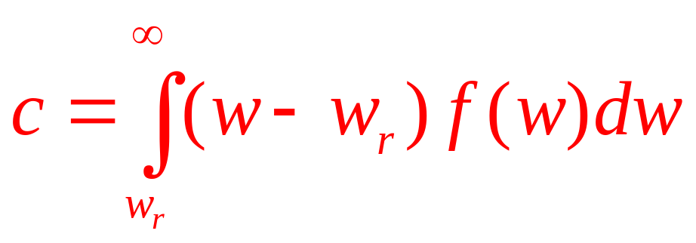
Job Search
Optimal reservation wage (w_{r})
  Expected gain from one more employer contact = the cost of that contact

Slide 44
Monopsony in the Labor Market
Monopsony in the labor market
  Only one buyer of labor
  Firm faces the entire market supply curve
  To increase its hiring of labor, the firm must pay a higher wage
    Not only to the ‘‘marginal worker’’
    But also additional wages to those workers already employed

Slide 45
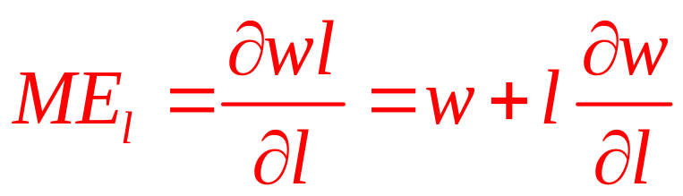
Monopsony in the Labor Market
Monopsony in the labor market
  The marginal expense (ME_{l}) of hiring an extra unit of labor exceeds its wage rate
  If the total cost of labor is wl, then
  In the competitive case: ∂w/∂l = 0 and ME_{l} = w
  If ∂w/∂l > 0, ME_{l} > w

Slide 46
Monopsony in the Labor Market
Marginal input expense
  The marginal expense (ME) associated with any input
  Is the increase in total costs of the input that results from hiring one more unit
  If the firm faces an upward-sloping supply curve for the input
    The marginal expense will exceed the market price of the input

Slide 47
Monopsony in the Labor Market
A profit-maximizing firm
  Hire any input up to the point: MRP_{l} = ME_{l}
  If MRP_{l} > ME_{l}
    Hire more workers - increase revenues more than costs
  If MRP_{l} < ME_{l}
    Reduce employment – lower costs more rapidly than revenues

Slide 48
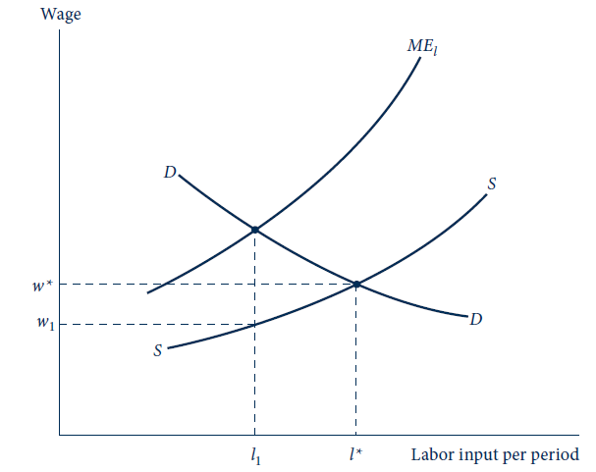
16.4 Pricing in a Monopsonistic Labor Market
If a firm faces a positively sloped supply curve for labor (S), it will base its decisions on the marginal expense of additional hiring (ME_{l}). Because S is positively sloped, the ME_{l} curve lies above S. The curve S can be thought of as an ‘‘average cost of labor curve,’’ and the ME_{l} curve is marginal to S. At l₁ the equilibrium condition ME_{l} = MRP_{l} holds, and this quantity will be hired at a market wage rate w₁. Notice that the monopsonist buys less labor than would be bought if the labor market were perfectly competitive (l*).

Slide 49
16.4 Monopsonistic Hiring
Coal mine’s workers
  Can dig 2 tons per hour
  Coal sells for $10 per ton
  So, MRP_{l} = $20 per hour
Coal mine – monopsony
  Faces a labor supply curve: l = 50w
  The firm’s wage bill : wl = l²/50
  The marginal expense: ME_{l} = ∂wl/∂l = l/25
Setting ME_{l} = MRP_{l}:
  Optimal quantity of labor is 500
  Optimal wage is $10

Slide 50
Labor Unions
If association with a union was wholly voluntary
  We can assume that every member derives a positive benefit
With compulsory membership
  We cannot make the same claim
  Even if workers would benefit from the union, they may choose to be “free riders”

Slide 51
Labor Unions
Assume
  The goals of the union are representative of the goals of its members
Use a monopoly model to examine unions
  The union faces a demand curve for labor
  As the sole supplier, it can choose at which point it will operate
    This point depends on the union’s goals

Slide 52
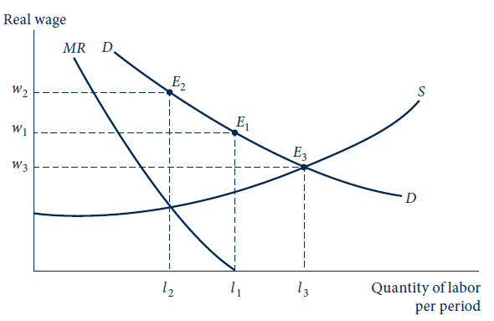
16.5 Three Possible Points on the Labor Demand Curve That a Monopolistic Union Might Choose
A union has a monopoly in the supply of labor, so it may choose its most preferred point on the demand curve for labor. Three such points are shown in the figure. At point E₁, total labor payments (w · l) are maximized; at E₂, the economic rent that workers receive is maximized; and at E₃, the total amount of labor services supplied is maximized.

Slide 53
16.5 Modeling a Union
A monopsonistic hirer of coal miners
  Faces a supply curve: l = 50w
  Assume a MRP of labor curve: MRP = 70 – 0.1l
Set MRP = ME_{l}
  No effective union: l*=500 workers, w*= $10
Effective union control:
  Competitive solution (E₃): l*=583, w*=11.7
  Maximize total wage bill (E₁): l*=350, w*=35
  Maximize economic rent per worker (E₂): l*=318, w*=38.2

Slide 54
16.6 A Union Bargaining Model
A firm and a union engage in a two-stage game
  First stage: union sets the wage rate its workers will accept
  Second stage: firm chooses its employment level
  The game can be solved by backward induction
  The firm’s second-stage problem is to maximize its profits: π = R(l) – wl
  The first-order condition for a maximum: R’(l) = w

Slide 55
16.6 A Union Bargaining Model
Assuming that l* solves the firm’s problem
  The union’s goal is to choose w to maximize utility: U(w,l) = U[w,l*(w)]
  The first-order condition for a maximum is
U₁ + U₂l’ = 0 or U₁/U₂ = - l’
    The union should choose w so that its MRS is equal to the absolute value of the slope of the firm’s labor demand function
    The w*, l* combination resulting from this game is a Nash equilibrium

Slide 56
16.6 A Union Bargaining Model
Efficiency of the labor contract
  The labor contract w*, l* is Pareto inefficient
  Because U₁/U₂ = -l’
    Small movements along the firm’s labor demand curve (l) leave the union equally well-off
    But the envelope theorem implies that a decrease in w must increase profits to the firm
    Hence there must exist a contract w^{p}, l^{p} (where
    w^{p} < w* and l^{p} > l*) with which both the firm and union are better off

